Slide 1


Prediction of Myocardial Infraction Complications
Presented by:
Deepthi Pai Manoor

Slide 2
Myocardial Infraction
Most challenging problems of modern medicine.
Chronic stress factors, irregular and improper nutrition intake.
High mortality rate within a short period of time.
Complications :
Pulmonary Edema
Myocardial rupture
Dressler syndrome
Chronic heart failure
Relapse of the myocardial
Post-infarction angina
Lethal outcome

Slide 3
Objective:
To build the best model to predict the patient’s that are more likely to have chronic heart failure.
Based on information about the patient the suggested database can be utilized to predict complications of Myocardial Infarction (MI).
SEMMA process will be followed to build the model as below:
Sample
Explore
Modify
Model
Assess

Slide 4
SAMPLE
ANALYSE
EXPLORE
MODIFY
MODEL
In the given database, we can see 124 columns and 1699 rows. Patients' independent statistics, their state at the time of admission, and their medical history are represented.
The nominal variable "Chronic Heart Failure" is the goal variable in this data collection. This will reveal whether the patient has encountered chronic heart failure.

Slide 5
SAMPLE
ANALYSE
EXPLORE
MODIFY
MODEL
Variables :
Out of 124 columns, based on the definitions and theoretical knowledge, 20 variables were shortlisted to pre-process further.

Slide 6
SAMPLE
ANALYSE
EXPLORE
MODIFY
MODEL
Variable and Description | Type
Age | Continuous
Gender | Nominal
Presence of chronic Heart failure (HF) in the anamnesis (ZSN_A) | Nominal
Chronic bronchitis in the anamnesis | Nominal
Presence of a lateral myocardial infarction (left ventricular) | Nominal
ECG rhythm at the time of admission to hospital sinus | Nominal
ECG rhythm at the time of admission to hospital atrial fibrillatio | Nominal
ECG rhythm at the time of admission to hospital idioventricular | Nominal
ECG rhythm at the time of admission to hospital sinus with a heart rate above 90 | Nominal
ECG rhythm at the time of admission to hospital sinus with a heart rate below 60l | Nominal
Time elapsed from the beginning of the attack of CHD to the hospital | Nominal
Type 1 Second-degree AV block on ECG at the time of admission to hospital | Nominal
Type 2 Second-degree AV block on ECG at the time of admission to hospital | Nominal
Use of opioid drugs in the ICU in the third day of the hospital period | Nominal
Ventricular fibrillation | Nominal
Pulmonary edema | Nominal
Dresser syndrome | Nominal
Relapse of the myocardial infarction | Nominal
Chronic Heart Failure | Nominal

Slide 7
SAMPLE
ANALYSE
EXPLORE
MODIFY
MODEL
Following pre-processing steps were followed:
1. Removed Missing Values.
The data value "?" is mentioned in the columns. A total of 462 rows are missing from the data set when these are taken into account as missing values.

Slide 8
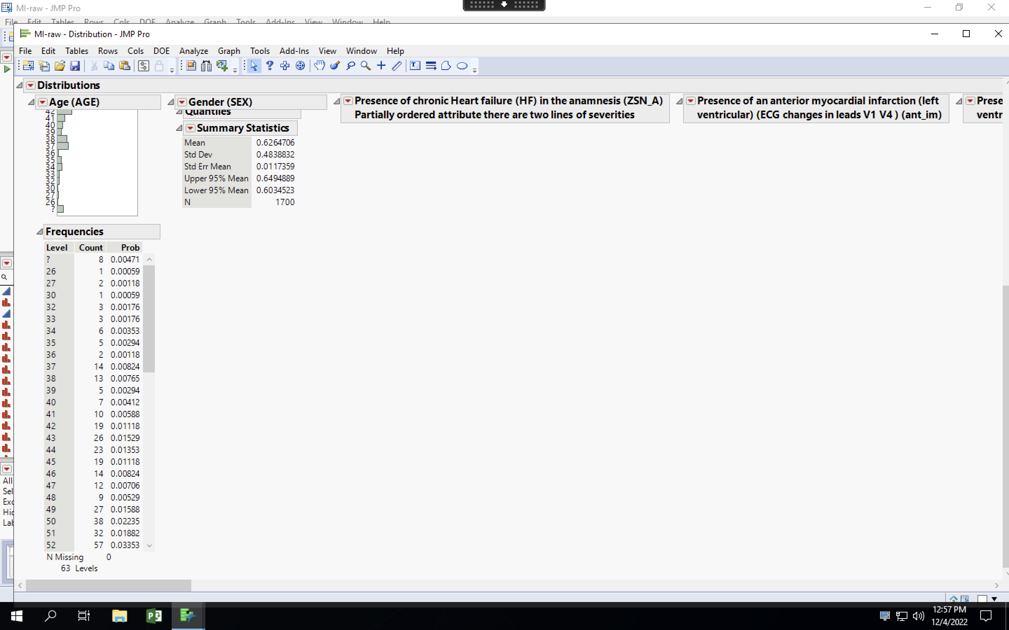
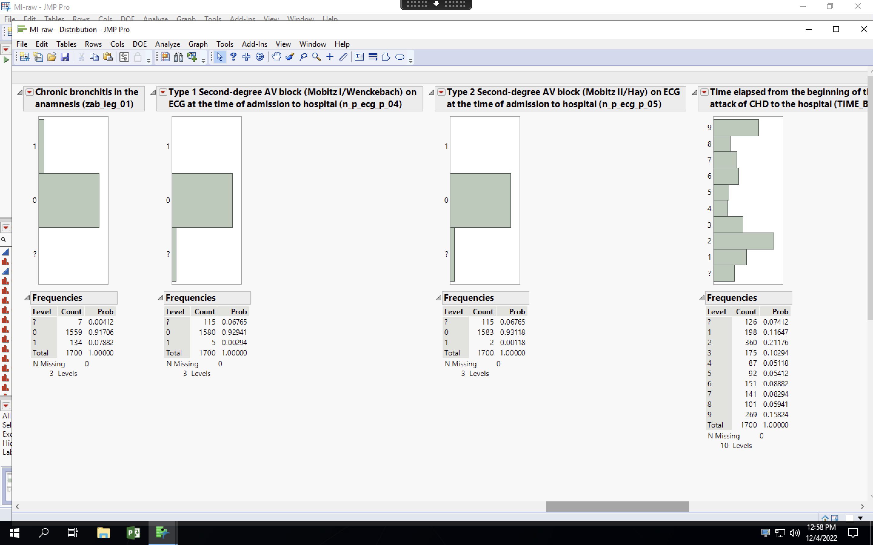
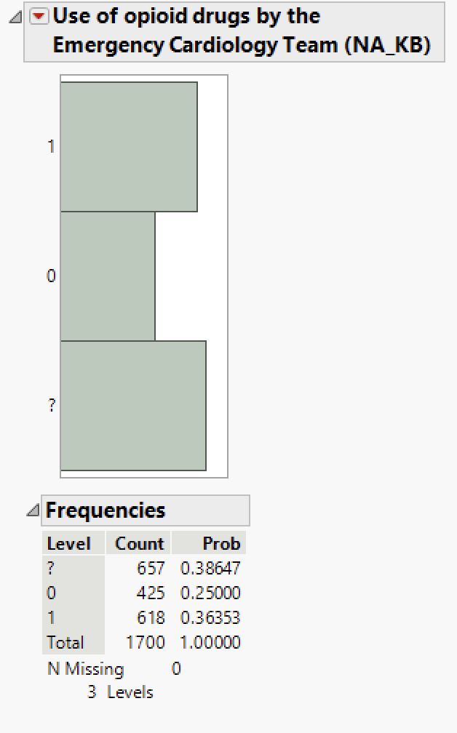
SAMPLE
ANALYSE
EXPLORE
MODIFY
MODEL
-Just a few screenshots are attached for your reference.

Slide 9
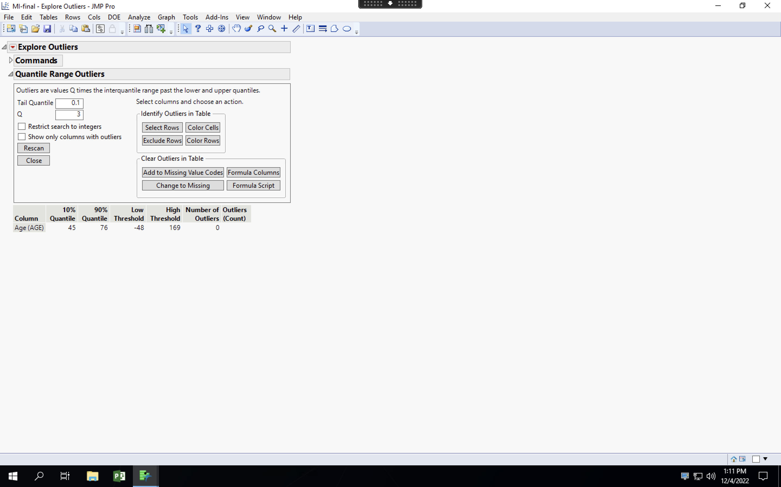
SAMPLE
ANALYSE
EXPLORE
MODIFY
MODEL
2. Outliers: There were no outliers in the dataset because most of the values were nominal.

Slide 10
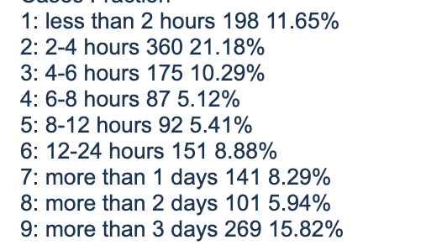
SAMPLE
ANALYSE
EXPLORE
MODIFY
MODEL
3. Conversion of datatypes:
The Time elapsed from the beginning of the attack of CHD to the hospital has been converted from continuous to categorical as per the definition. That is :

Slide 11
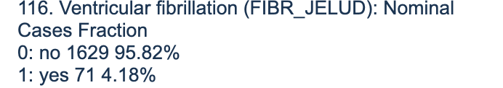
SAMPLE
ANALYSE
EXPLORE
MODIFY
MODEL
Ventricular fibrillation has been converted from continuous to nominal as per the definition.

Slide 12
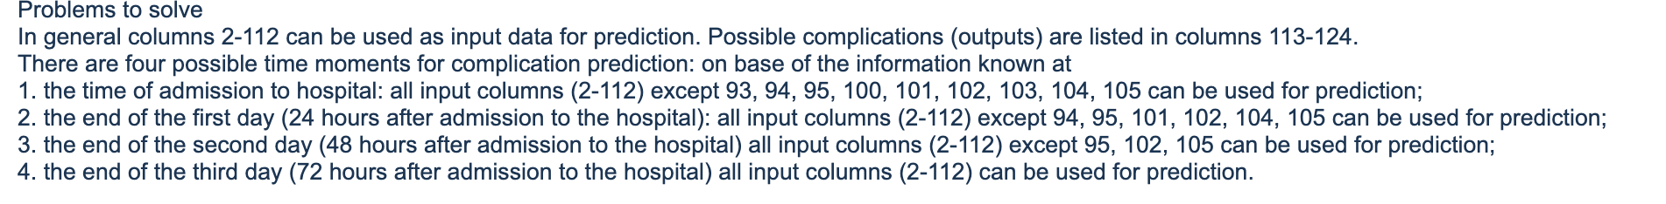
SAMPLE
ANALYSE
EXPLORE
MODIFY
MODEL
4. Exclusion of columns.
Only 20 of the 124 columns were taken into consideration for evaluation since, they either contain nearly constant values, a significant number of missing values, or no strong correlation with the target variable in accordance with the data on the website.
Source:
https://archive.ics.uci.edu/ml/datasets/Myocardial+infarction+complications

Slide 13
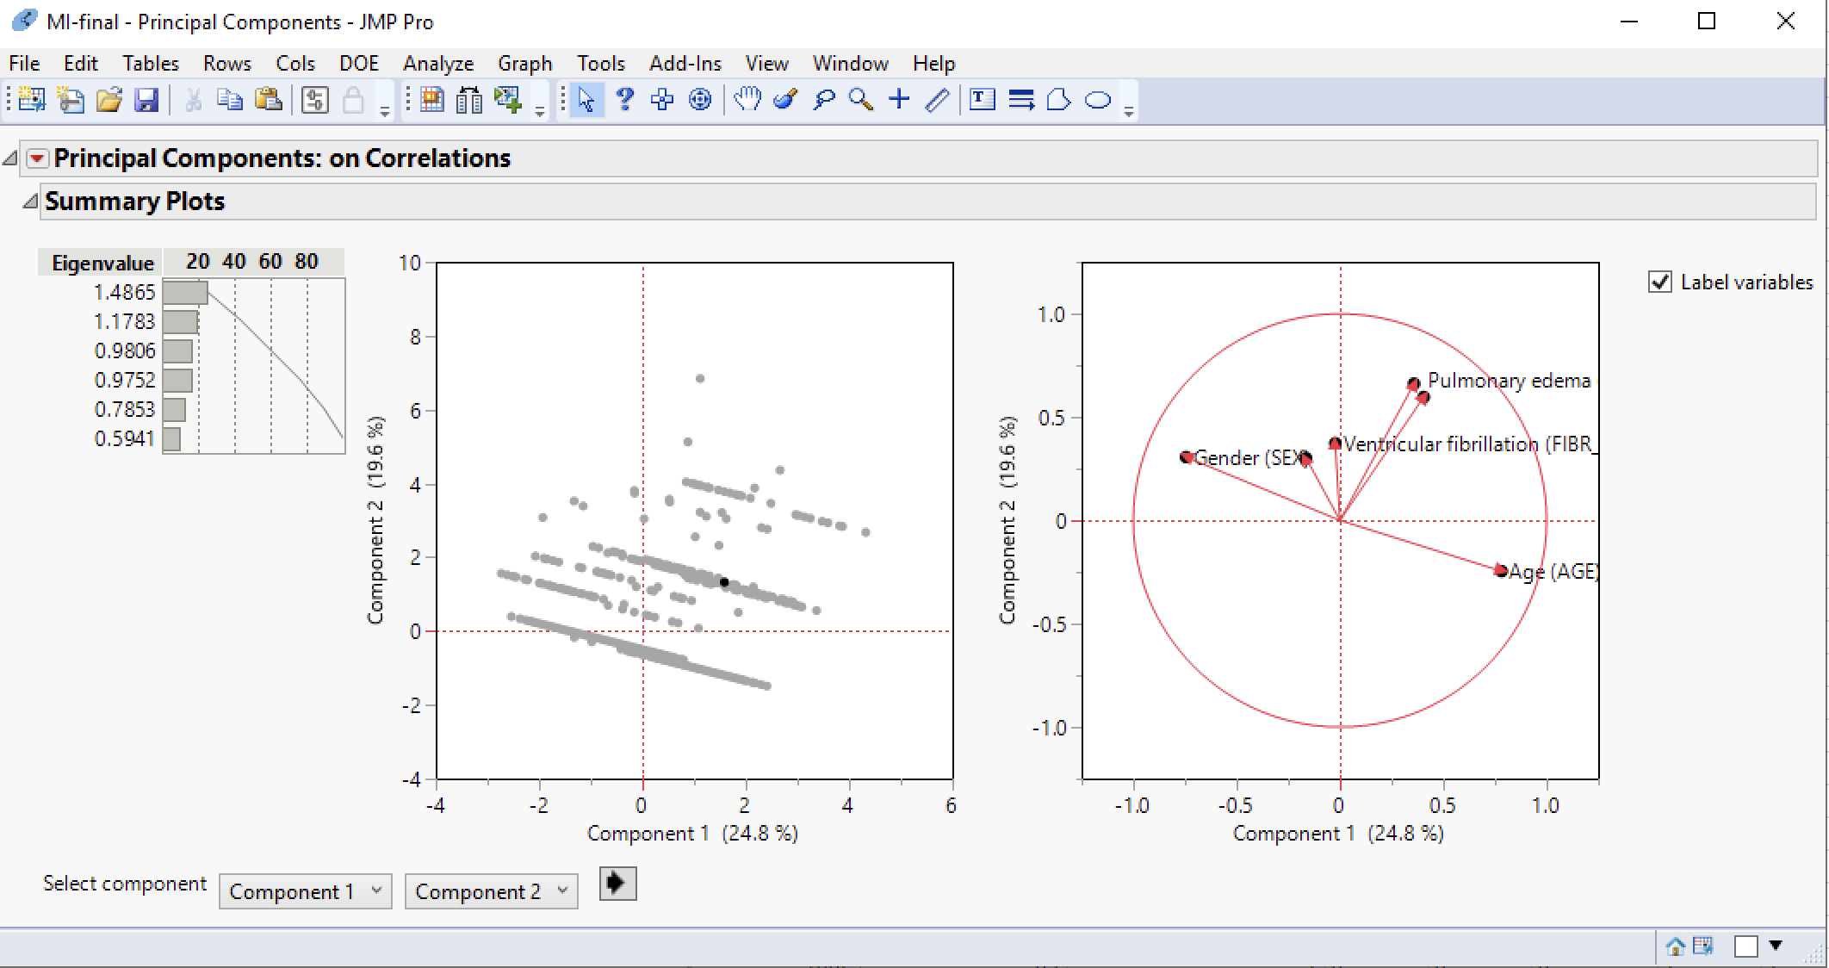
SAMPLE
ANALYSE
EXPLORE
MODIFY
MODEL
5. Principal Components
As there was no much co-relation between the variables, I have not taken any Principal Components for analysis. Rather worked on important variables as inputs.
Most of the datatype is Nominal.

Slide 14
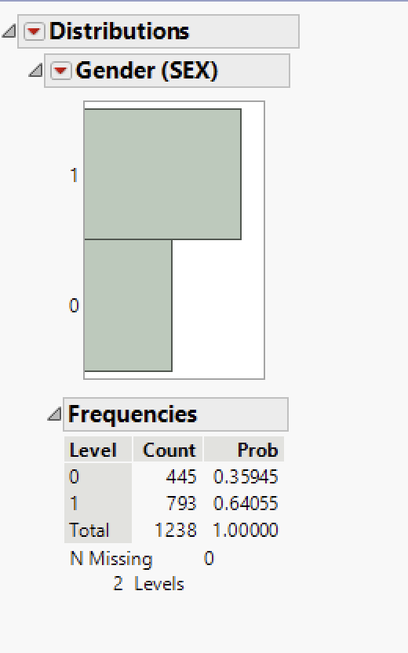
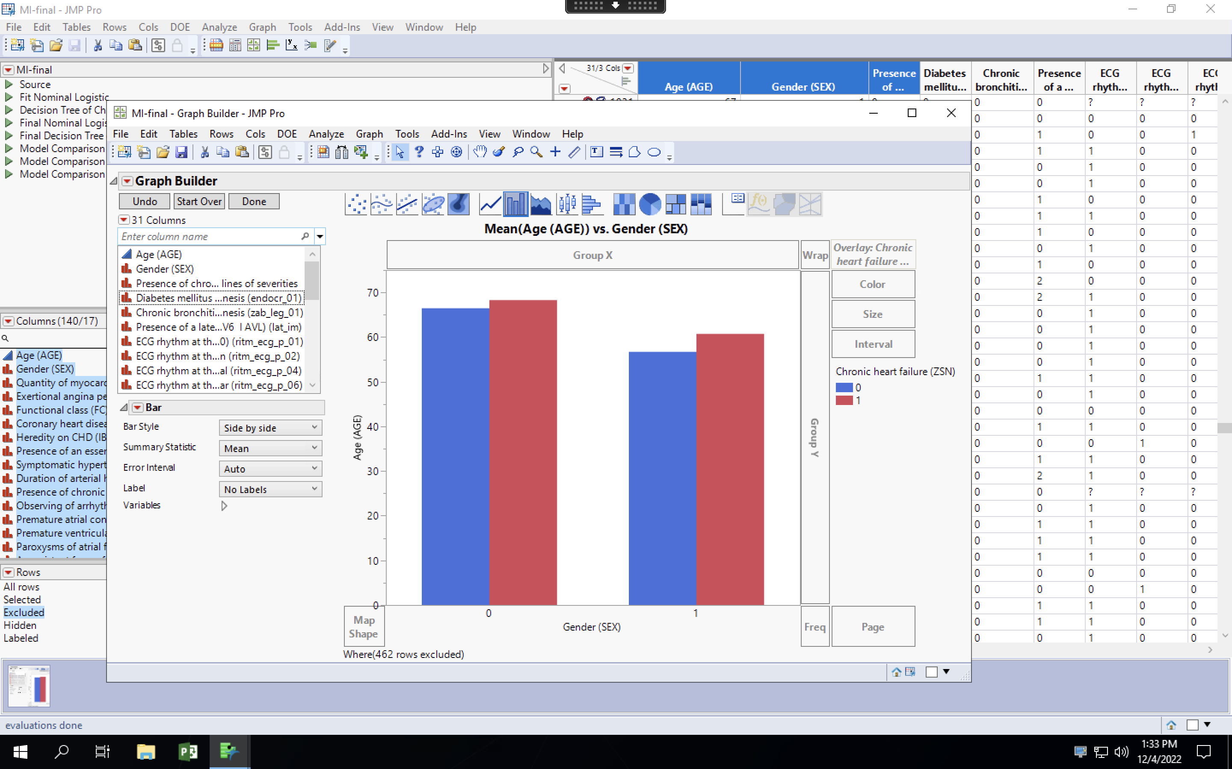
SAMPLE
ANALYSE
EXPLORE
MODIFY
MODEL
We can see from the patient data that men are more likely than women to develop chronic heart failure between the ages of 50 and 70 after experiencing Myocardial Infraction.

Slide 15
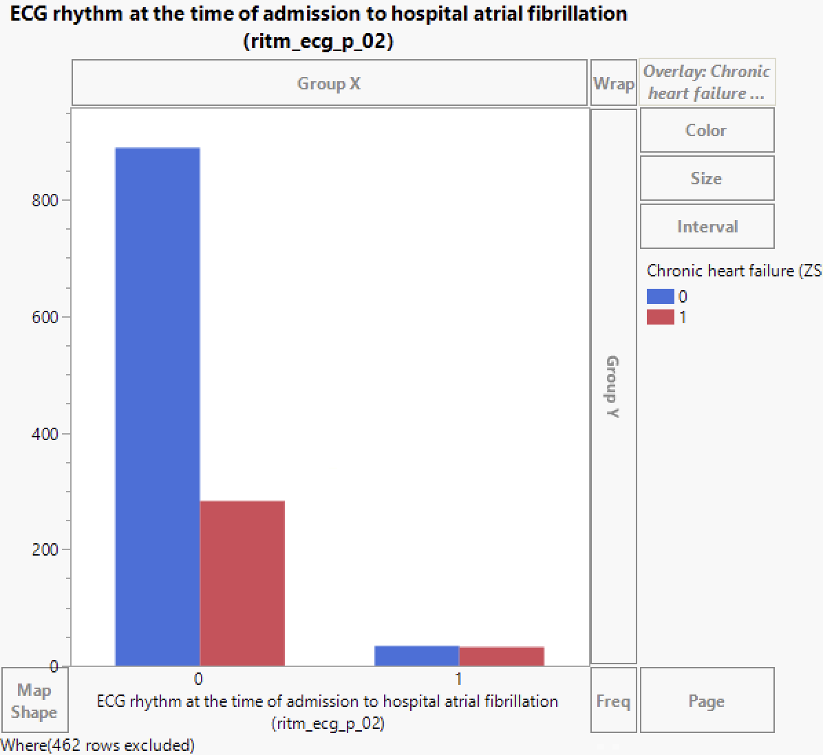
SAMPLE
ANALYSE
EXPLORE
MODIFY
MODEL
The patient has a greater than 90% probability of developing chronic heart failure if atrial fibrillation is present on the ECG at the time of hospital admission.

Slide 16
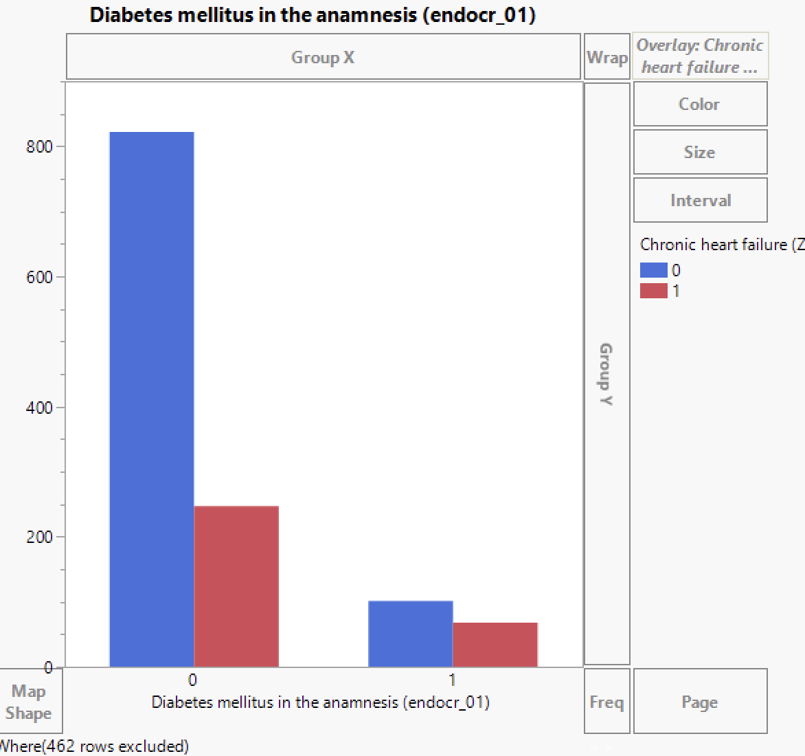
SAMPLE
ANALYSE
EXPLORE
MODIFY
MODEL
According to the patient data, there is a substantial likelihood that a patient would experience chronic heart failure if they previously had diabetes mellitus.

Slide 17
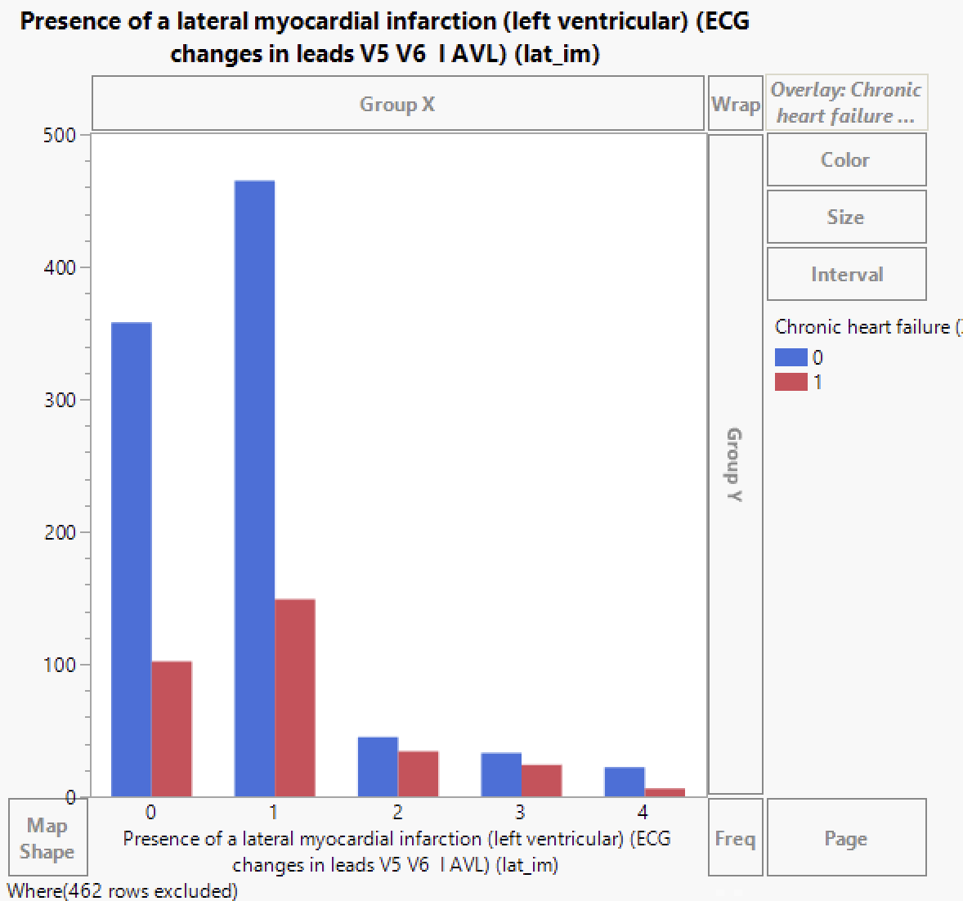
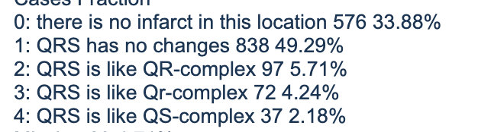
SAMPLE
ANALYSE
EXPLORE
MODIFY
MODEL
There is a high probability that a patient may have chronic heart failure due to the left ventricular complexity.

Slide 18
SAMPLE
ANALYSE
EXPLORE
MODIFY
MODEL
Decision Tree Model
Ensemble Model
Nominal Logistic Regression Model

Slide 19
SAMPLE
ANALYSE
EXPLORE
MODIFY
MODEL
Predicting "1" from the target variable is the class of interest. 34.12% is the percentage of "1."
Due to the low number of "1," stratified sampling was used to divide the data into training (i.e., 60%), validation (20%), and test (20%) groups.

Slide 20
Decision Tree Model - Best fit model
Decision trees are extremely useful for data analytics and machine learning because they break down complex data into more manageable parts.
Notes:
Decision trees are extremely useful for data analytics and machine learning because they break down complex data into more manageable parts

Slide 21
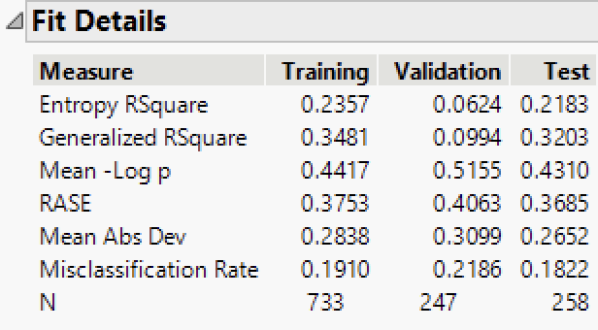
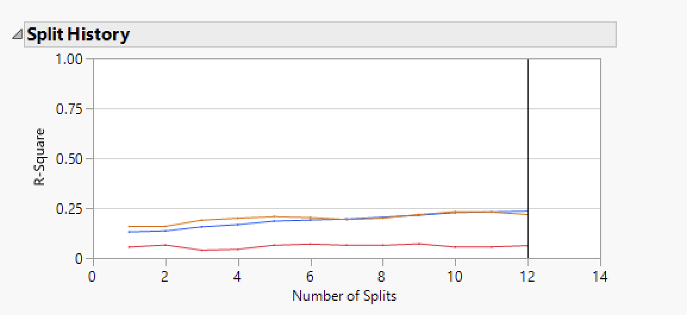
Decision Tree Model
Before tuning the model:

Slide 22
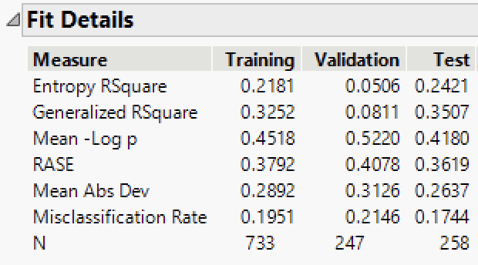
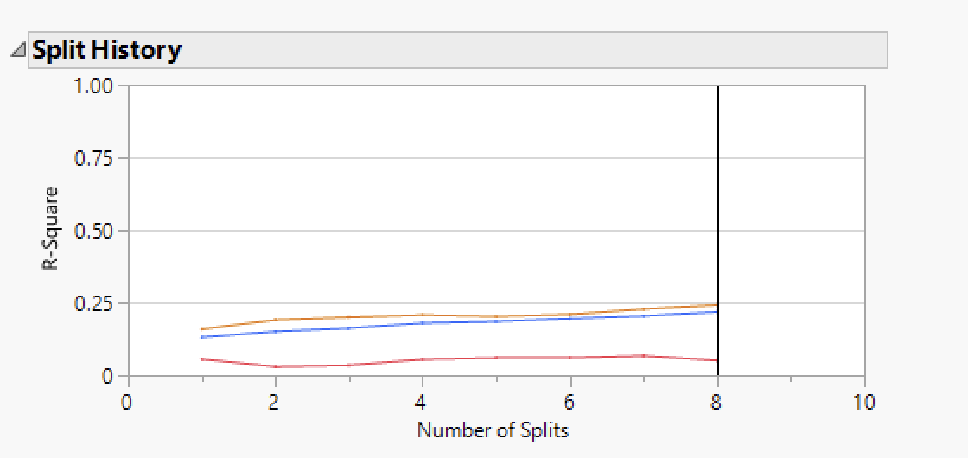
Decision Tree Model
After tuning the model:

Slide 23
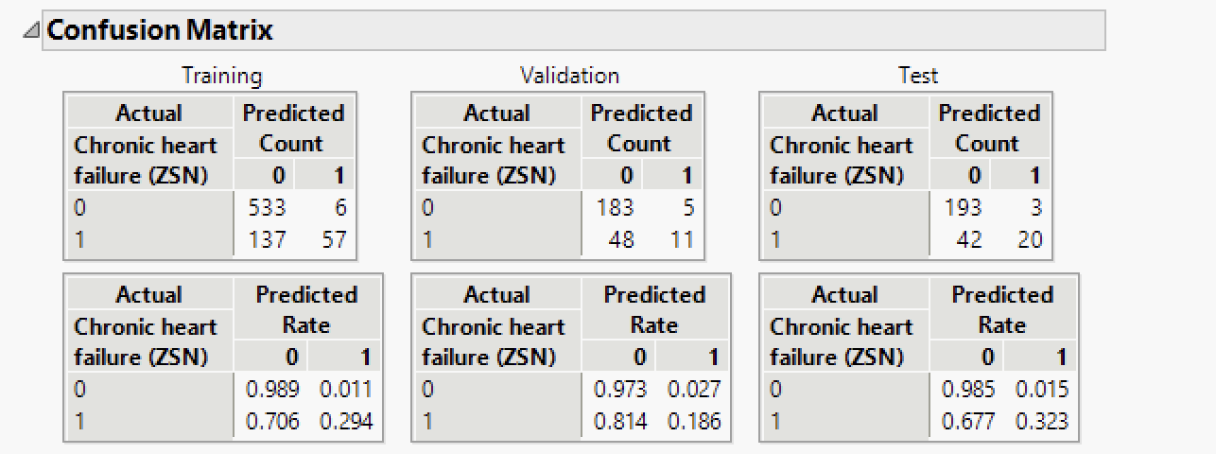
Decision Tree Model
After tuning the model:

Slide 24
Decision Tree Model
Initially, we had 12 splits but after pruning the splits down to 8, misinterpretation rate has decreased.
Details of the tuned model include:
Data Set | Misclassification rate | RASE | Total Accuracy | Accuracy of 1
Training | 19.51% | 0.3792 | 80.49% | 29.38%
Validation | 21.46% | 0.4078 | 78.54% | 18.60%
Test | 17.44% | 0.3619 | 82.50% | 32.20%

Slide 25
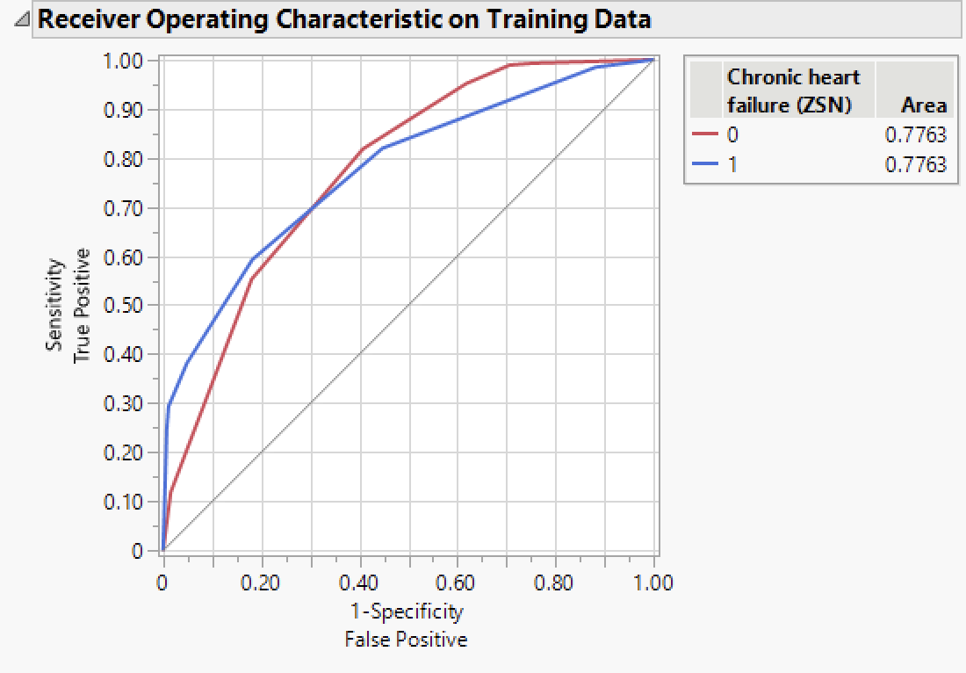
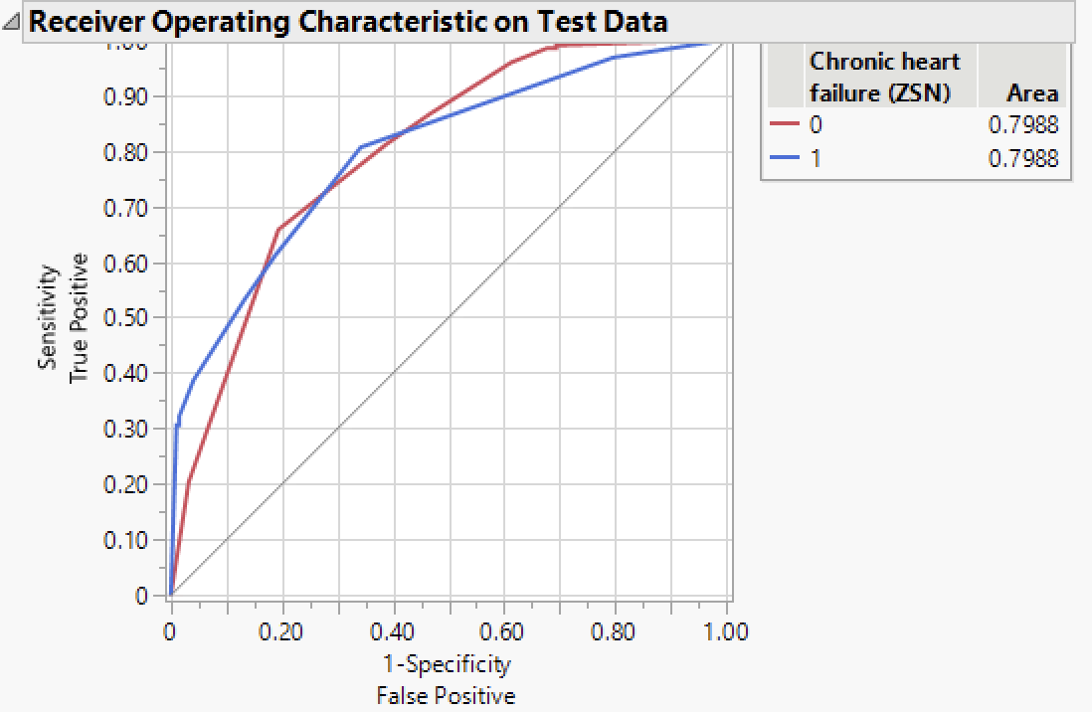
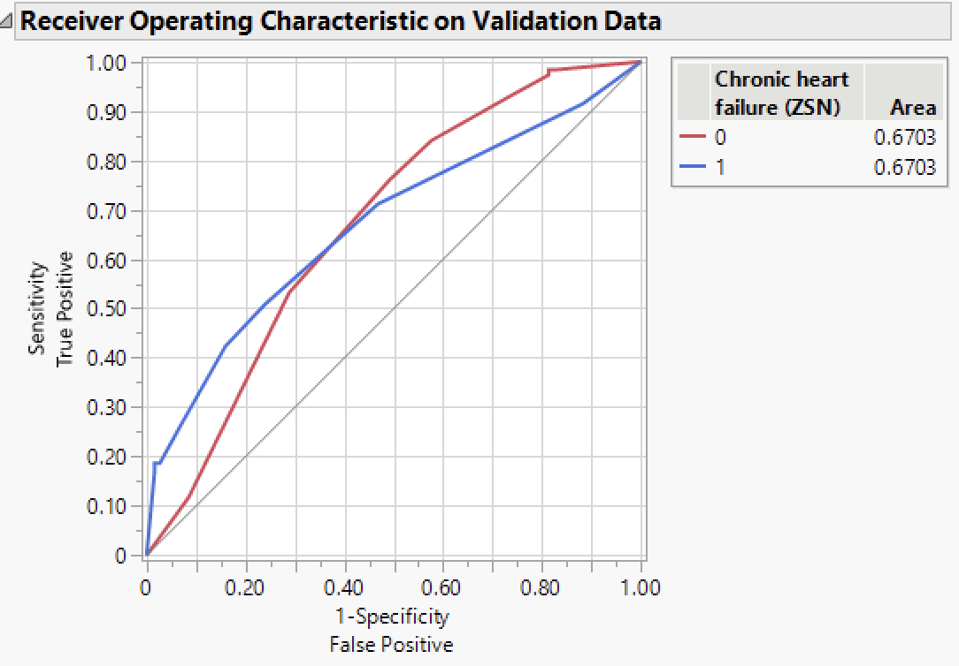
Decision tree model
ROC Curves for the Tuned Linear Regression Model

Slide 26
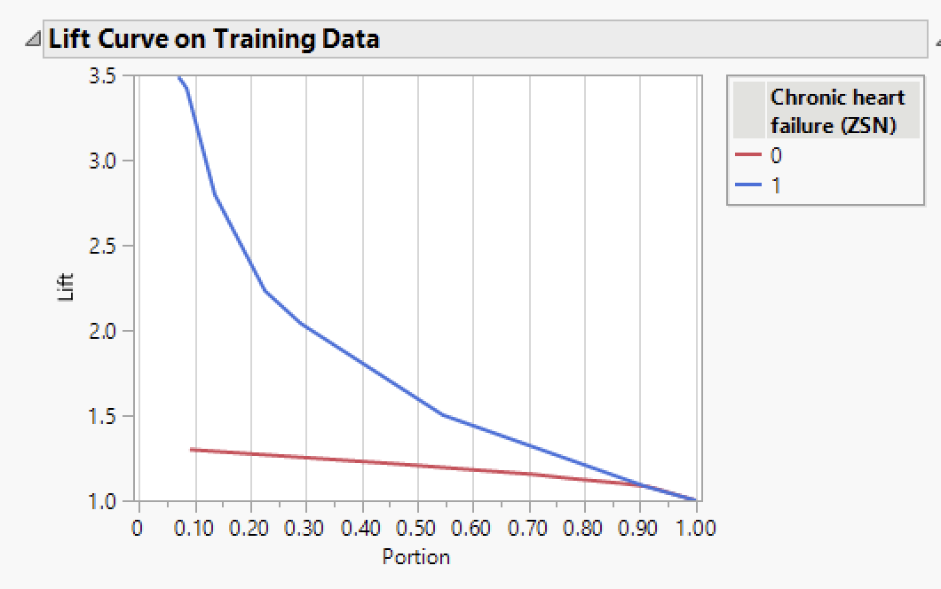
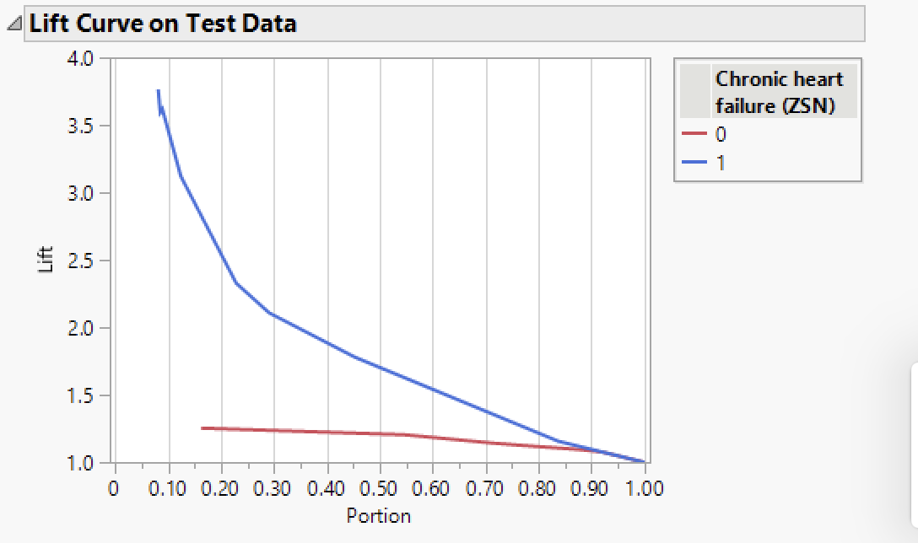
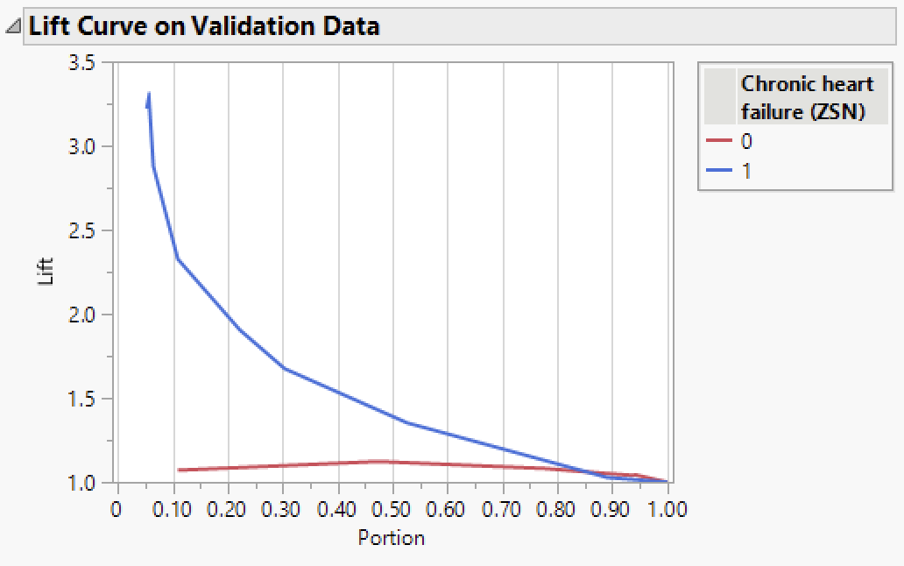
Decision tree model
Lift Curves for the Tuned Linear Regression Model

Slide 27
SAMPLE
ANALYSE
EXPLORE
MODIFY
MODEL
Selection Criteria:
In all 3 models, we can observe that there is no overfitting.
Accuracy of Nominal Logistic & Partition model are the same in the test set.
In Partition model, for test data partition AUC is greater than other models.
Partition model also has a lower RASE compared to the rest of the models.

Slide 28
CONCLUSION
Business Findings and Recommendations:
The main factors that influence whether persistent heart failure develops as a side effect of myocardial infarction are age, gender, and past medical records.
If atrial fibrillation is seen on the ECG at the time of hospital admission and there is a family history of chronic heart failure, there is a very high likelihood that the patient will develop chronic heart failure.
Therefore, older patients with already-evaluated medical issues such as diabetes, heart-related history, or chronic bronchitis should receive more precise care and should not hesitate in rushing to the hospital.
Notes:
Working with the dataset made it evident that there was minimal chance of forecasting the outcome of a myocardial infarction complication. Evidently, as people get older, they are more susceptible to stress and chronic ailments. In order to properly treat patients with past medical histories, doctors should pay close attention to them and be extremely cautious when taking their ECG results at the time of admission.
Finally, older people should not hesitate to rush to the hospital and should require more precise care.

Slide 29
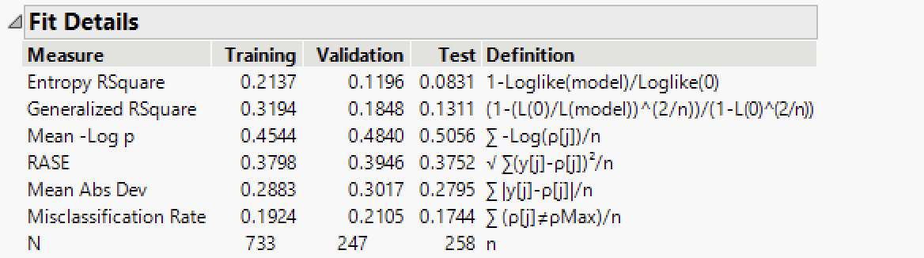
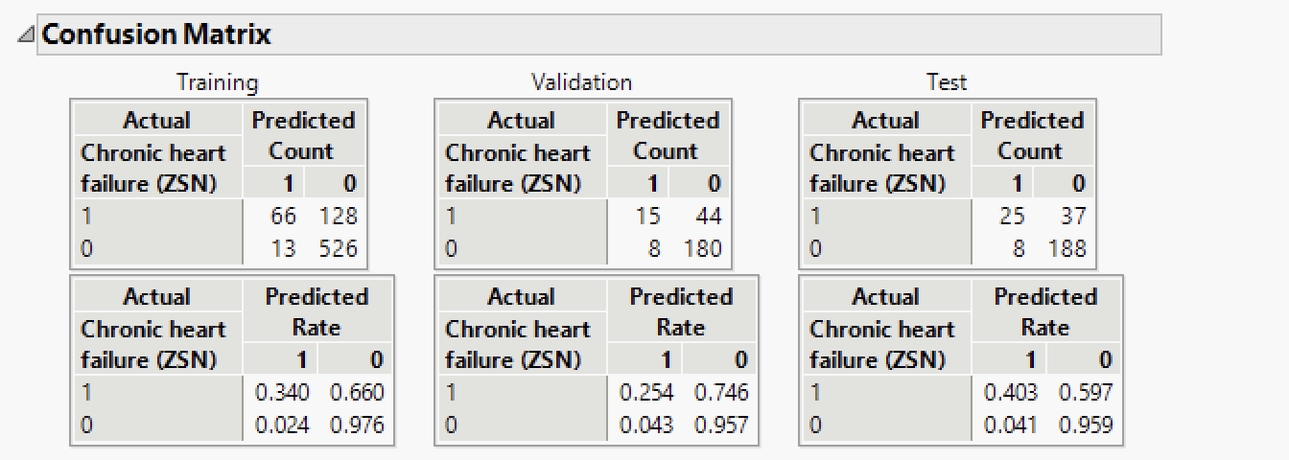
APPENDIX
Nominal Logistic Regression Model

Slide 30
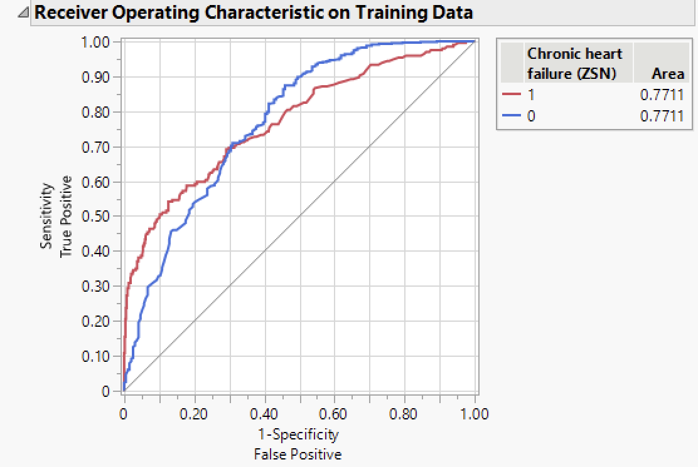
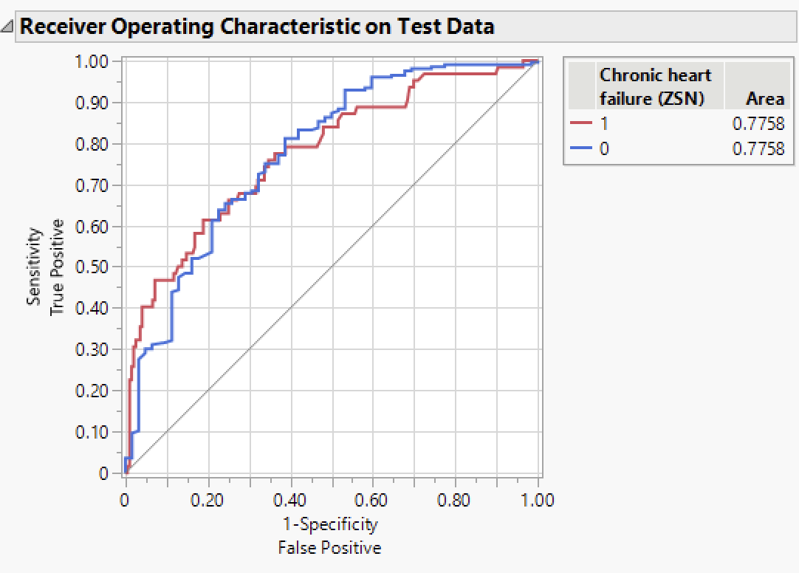
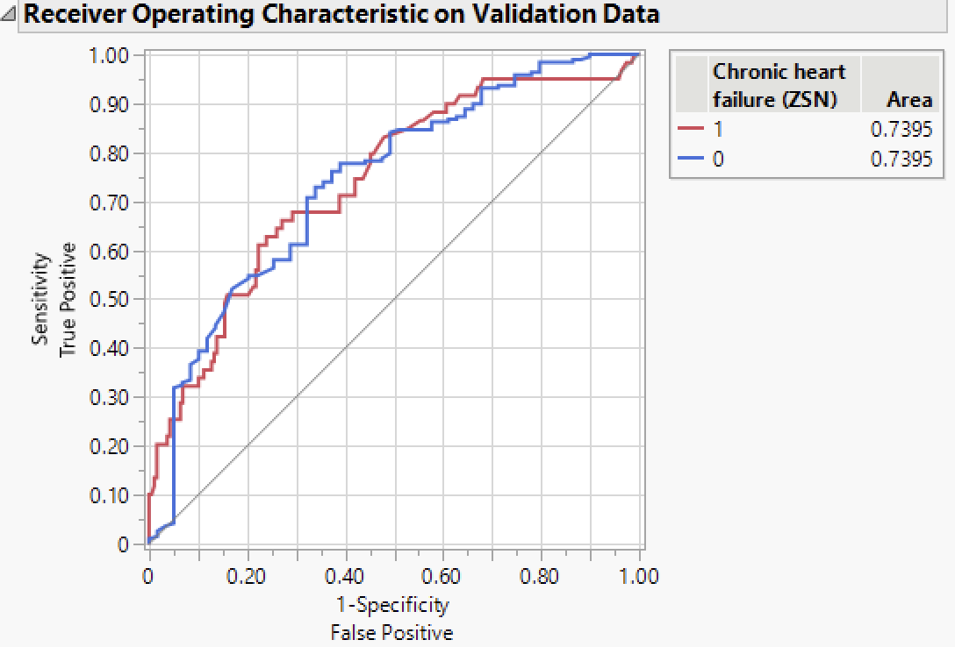
APPENDIX
Nominal Logistic Regression Model
ROC Curves for the Tuned Linear Regression Model
Data Set | Misclassification rate | RASE | Total Accuracy | Accuracy of 1
Training | 19.24% | 0.3798 | 80.76% | 34.02%
Validation | 21.05% | 0.3946 | 78.95% | 25.40%
Test | 17.44% | 0.3752 | 82.56% | 40.30%

Slide 31
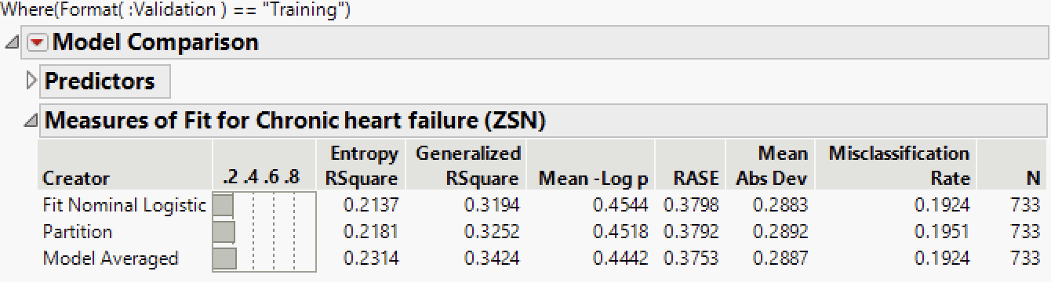
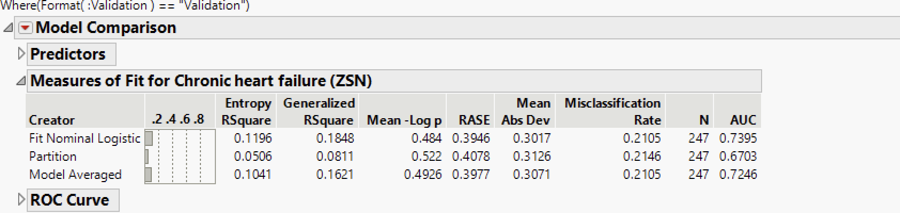
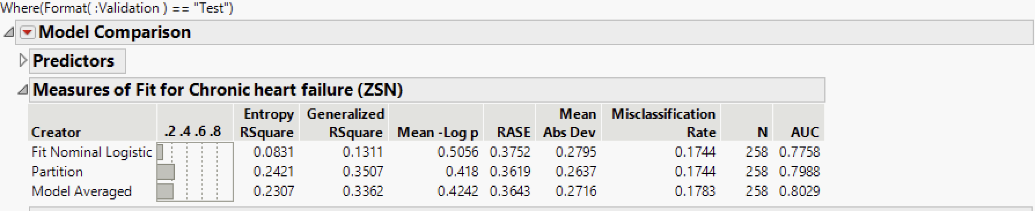
APPENDIX
ENSEMBLE MODEL:
Data Set | Misclassification rate | RASE | Total Accuracy
Training | 19.24 | 0.3753 | 80.76
Validation | 21.05 | 0.3977 | 78.95
Test | 17.83 | 0.3643 | 82.17

Slide 32
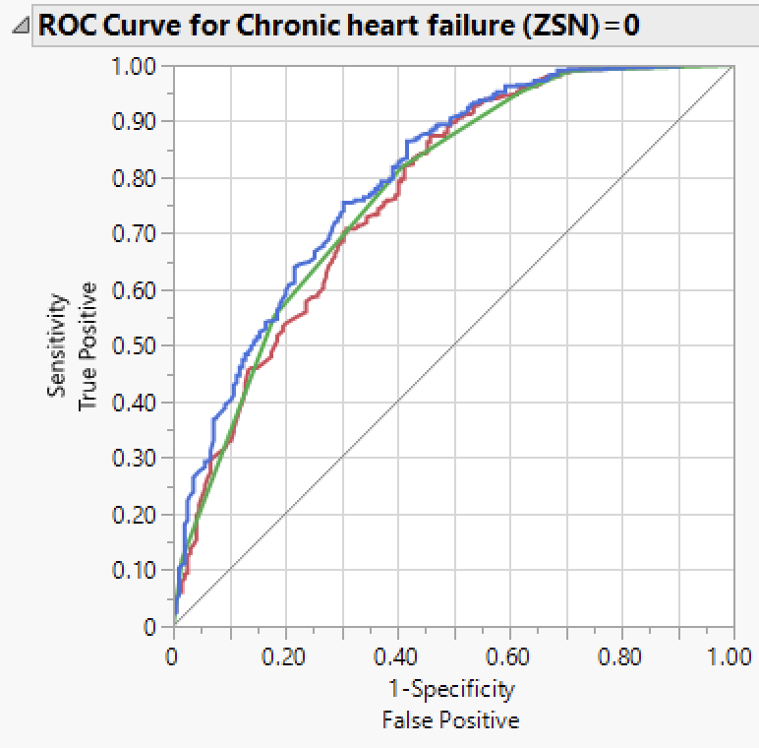
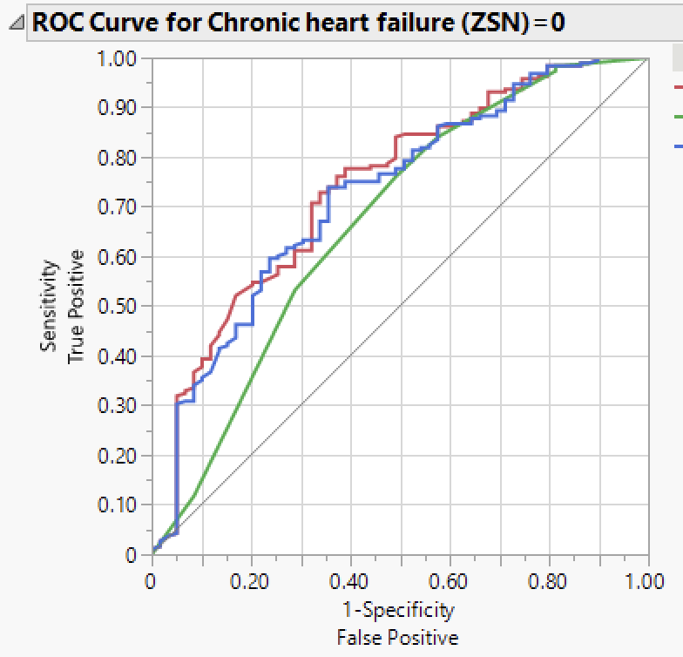
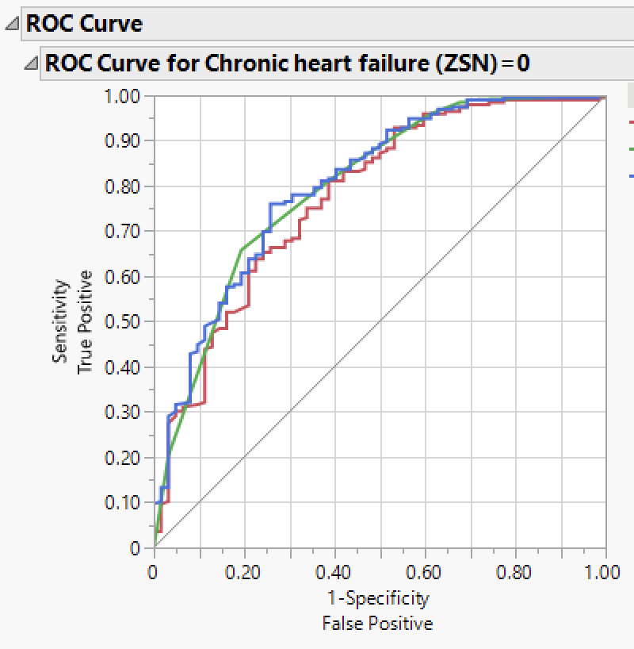
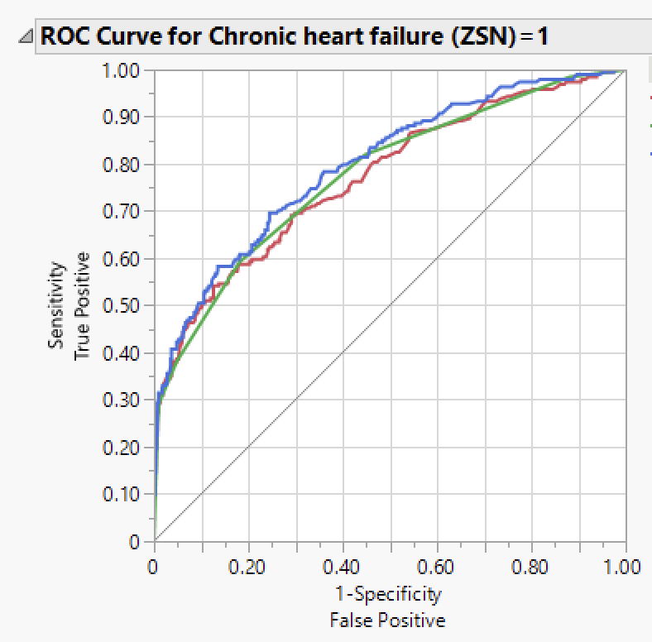
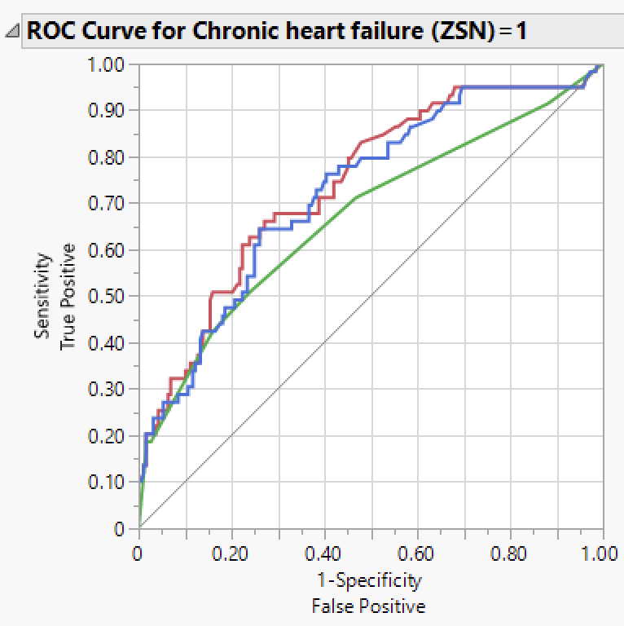
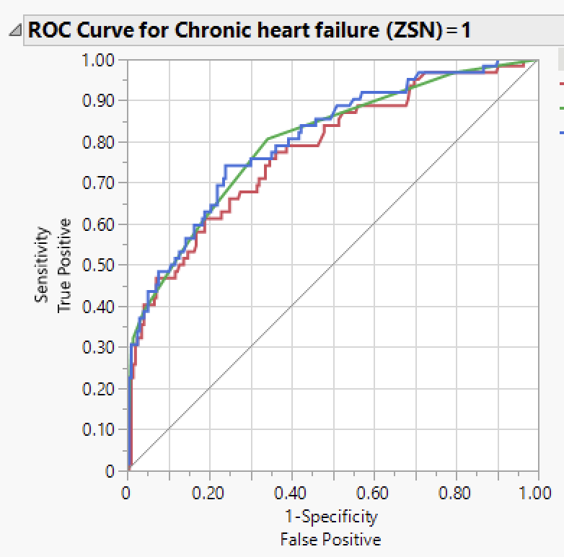
APPENDIX
ENSEMBLE MODEL:
Training
Validation
Testing

Slide 33
references
OPIM 5604 Video lectures
Shmueli, G. (2017). Data mining for business analytics: Concepts, techniques, and applications with JMP Pro. Hoboken, NJ: Wiley.
Dataset link: https://archive.ics.uci.edu/ml/datasets/Myocardial+infarction+complications

Slide 34


